Slide 1







TRANG AN PRIMMARY SCHOOL
English 4
Welcome to our class 4B

Slide 2


Warm up

Slide 3
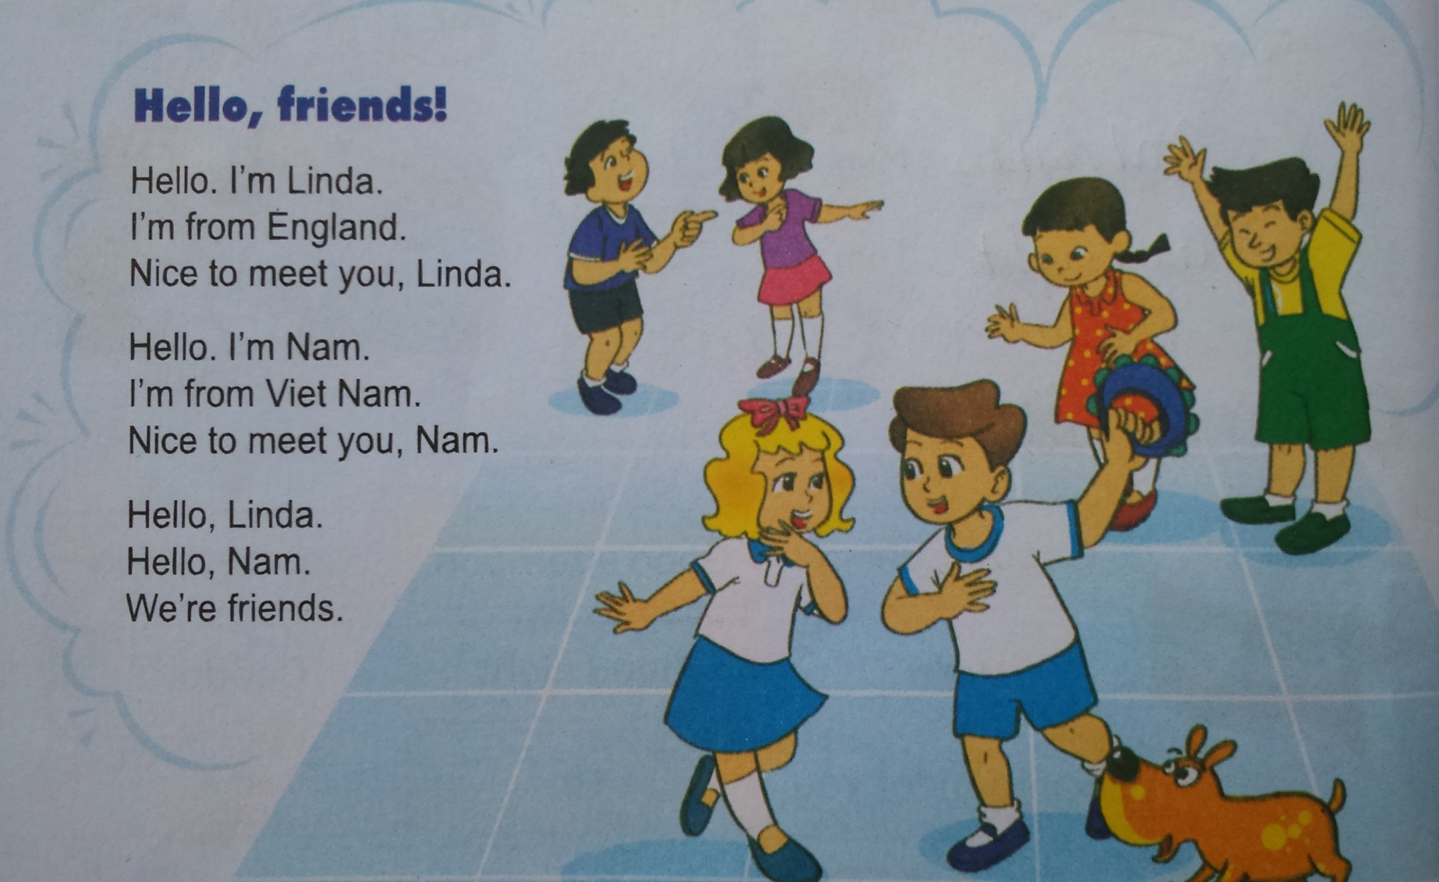


Slide 4
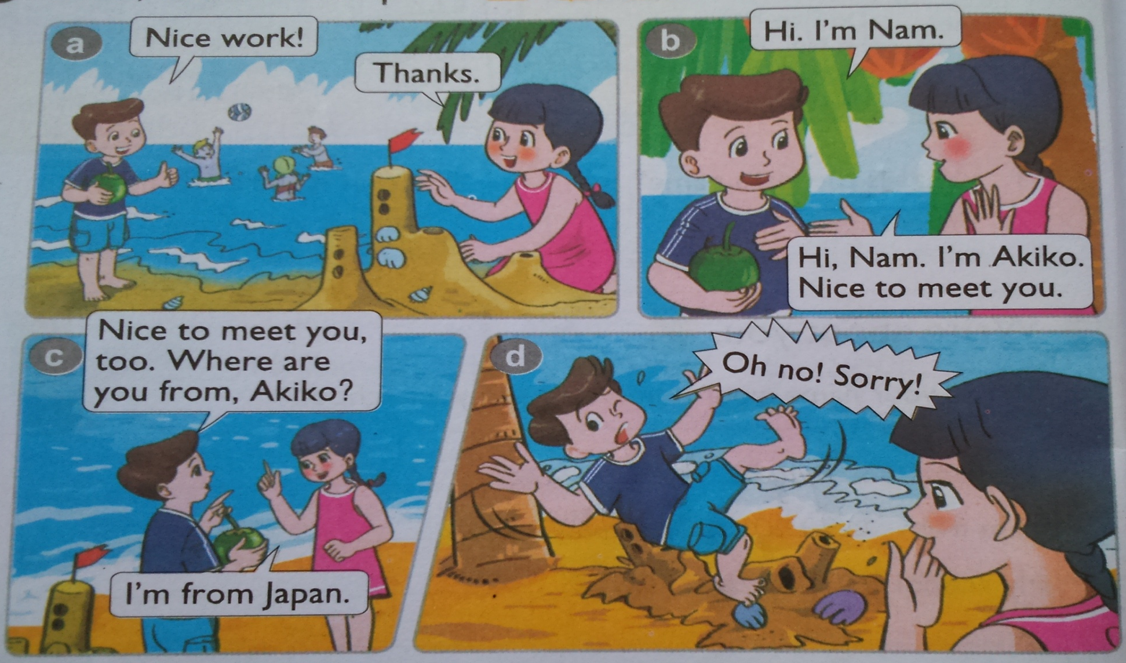
1. Look , listen and repeat.

Slide 5
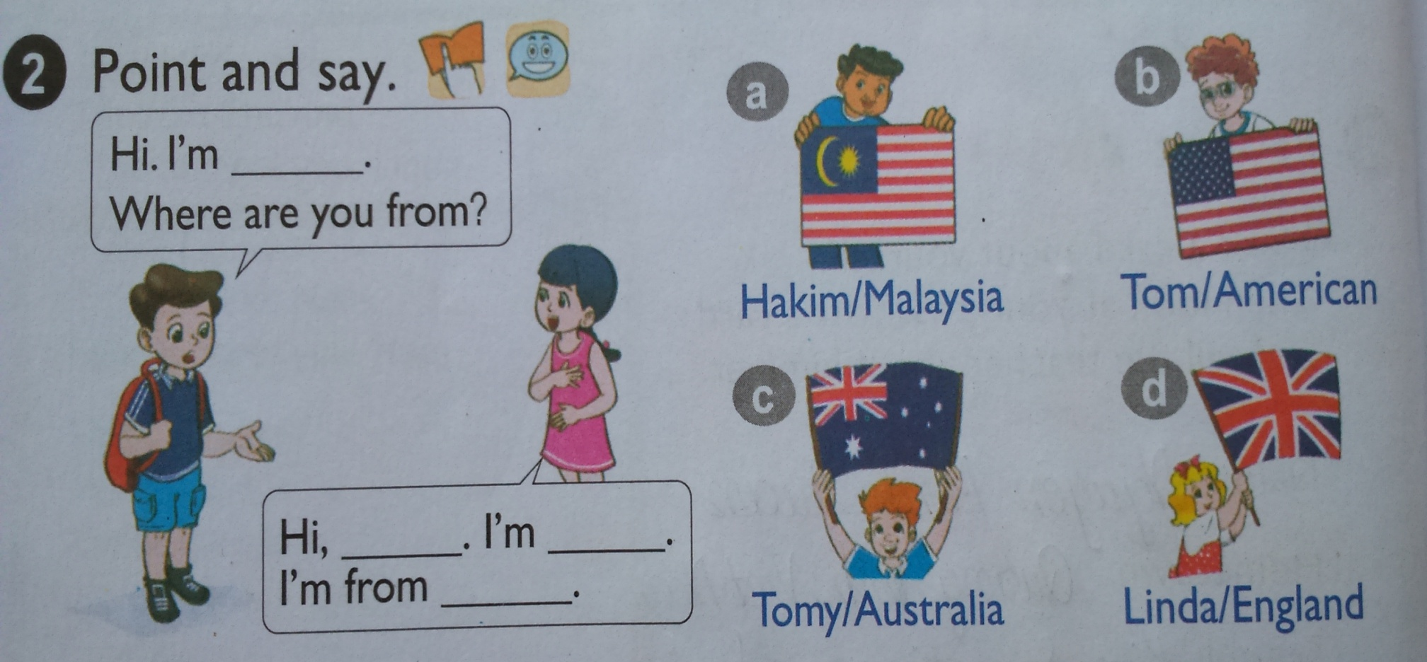
2. Point and say
Nam
Nam
Akiko
Japan

Slide 7
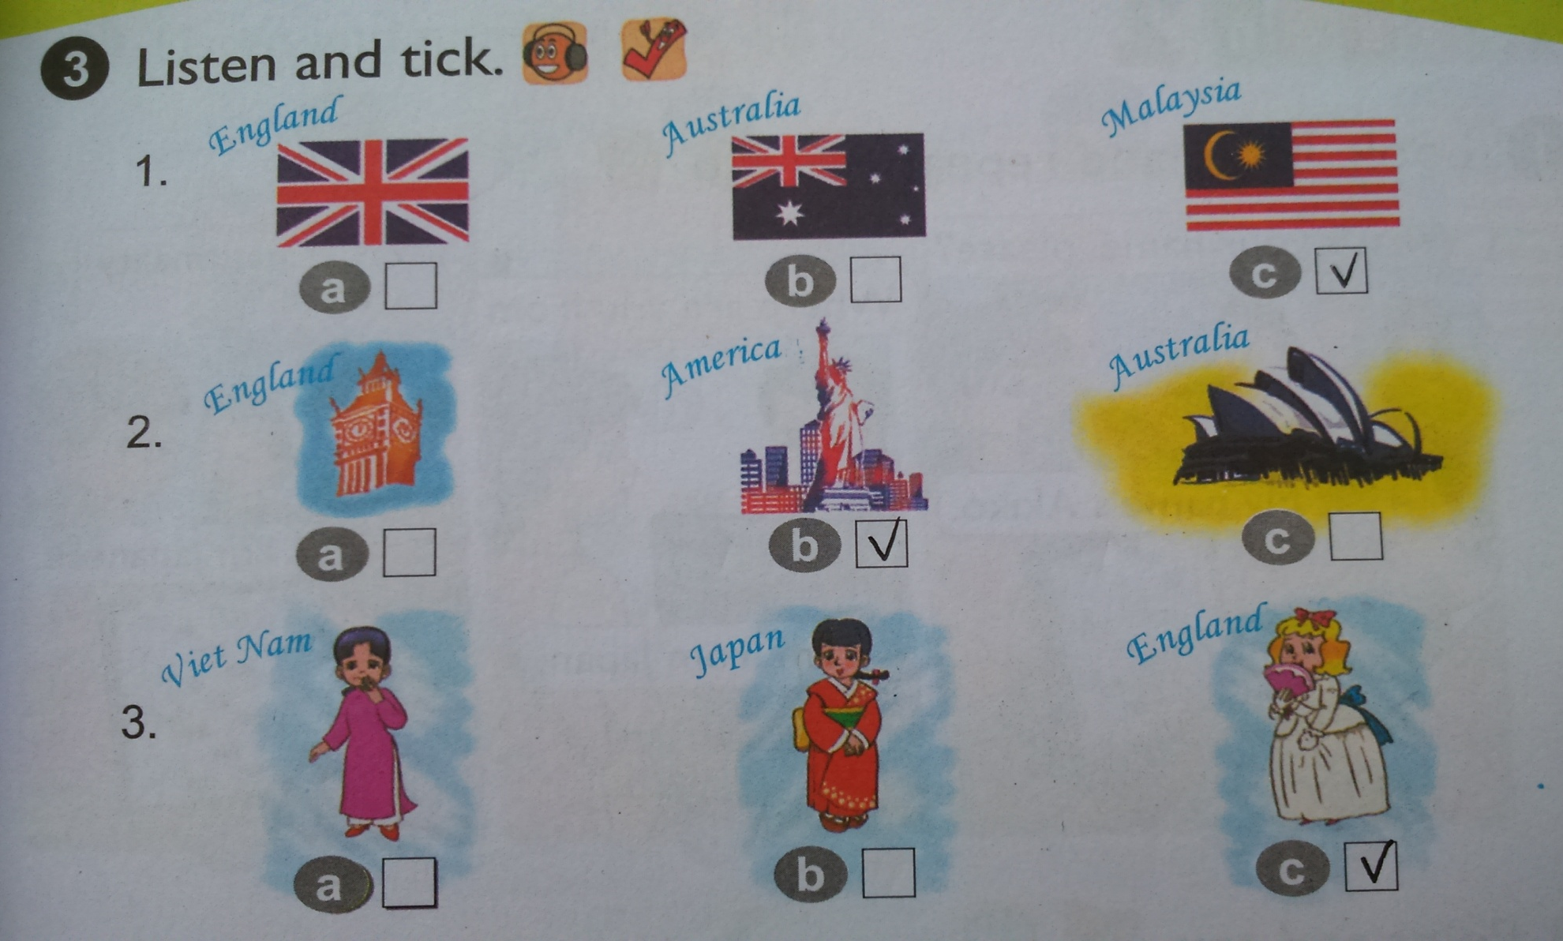

Slide 8


3. Listen and tick.

Slide 9


Slide 10
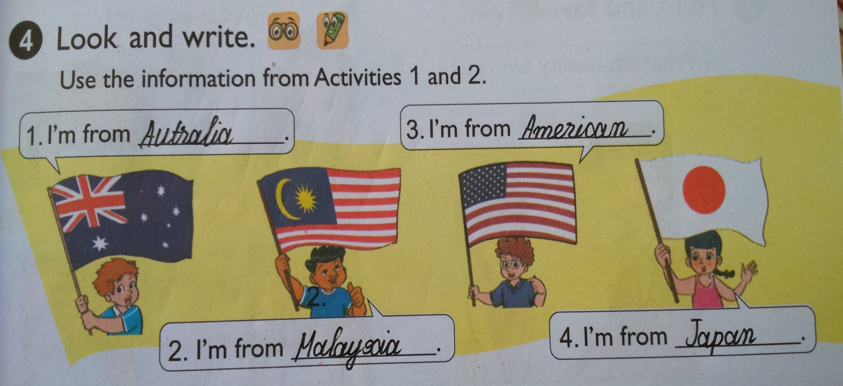
Australia.
Ameriaca.
Japan.
Malaysia.

Slide 11
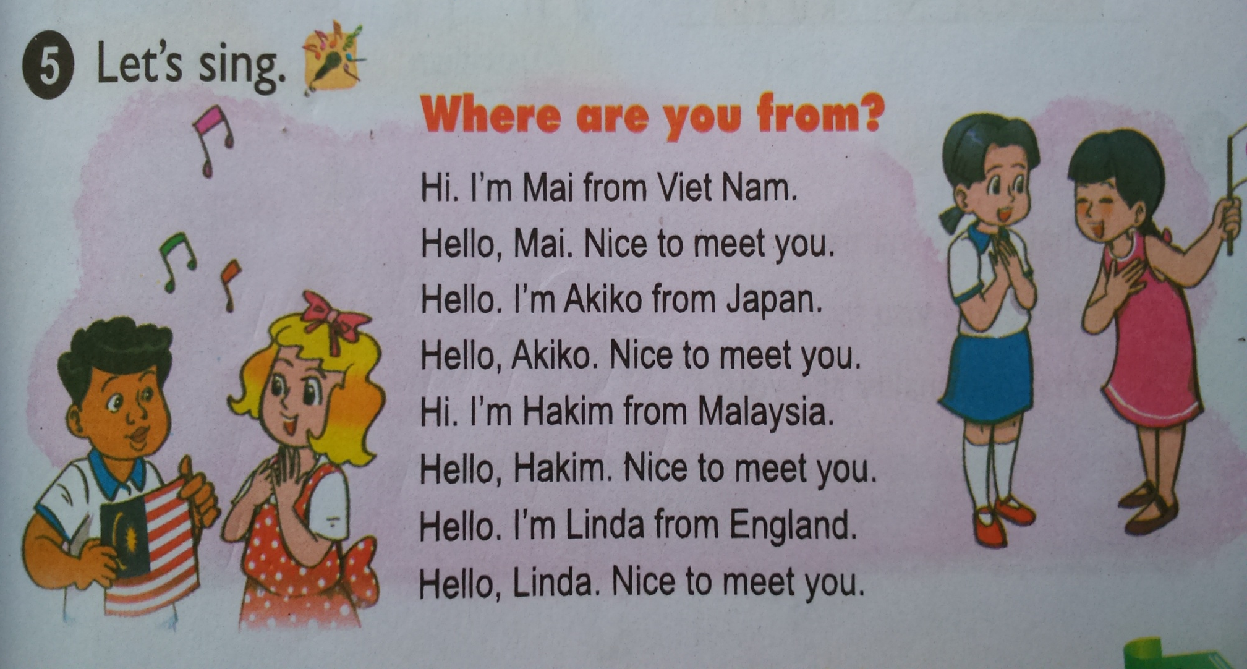

Slide 12


- Learn by heart the sing.

Slide 13

Goodbye
See you again

