Slide 1







TRANG AN PRIMARY SCHOOL
English 4
Welcome to our class 4A
Teacher: Tran Hong Anh
Academic year: 2016 - 2017

Slide 2


Warm up

Slide 3
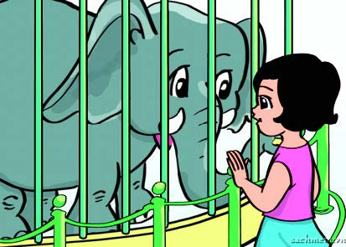
1
2
3
4

Slide 4
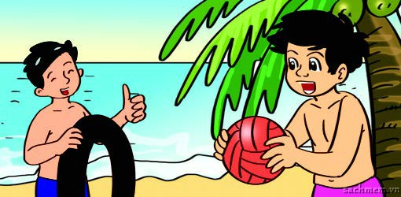
1
2
3
4

Slide 5
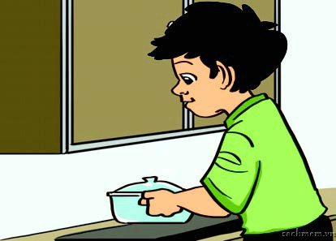
1
2
3
4

Slide 7
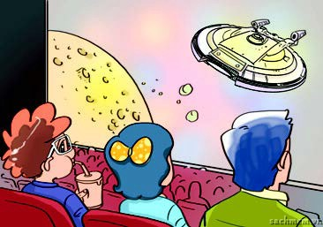
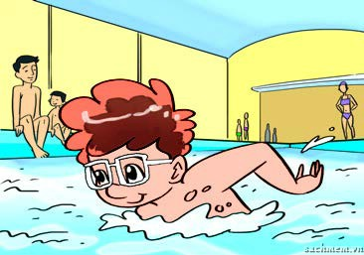
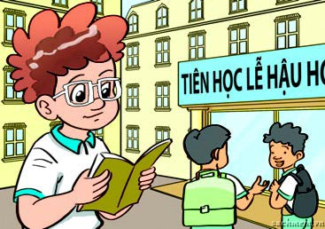
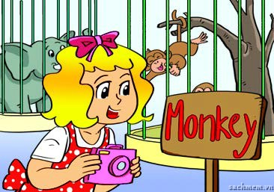

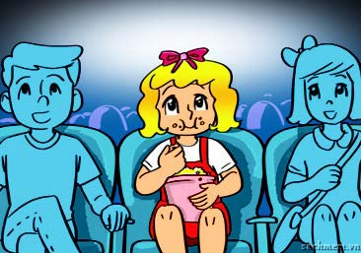
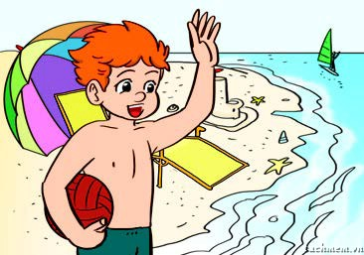
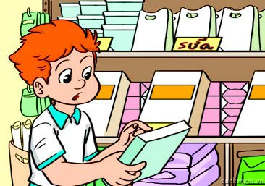
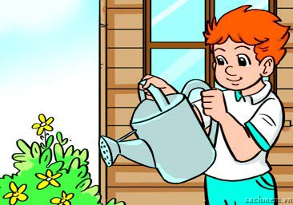
3. Listen and tick.
1.
a
b
c
2.
a
b
c
a
b
c
3.

Slide 8

3. Listen and tick.

Slide 9

3. Listen and tick.
1.
a
b
c
2.
a
b
c
a
b
c
3.

Slide 10
Game
Guess the word

Slide 12
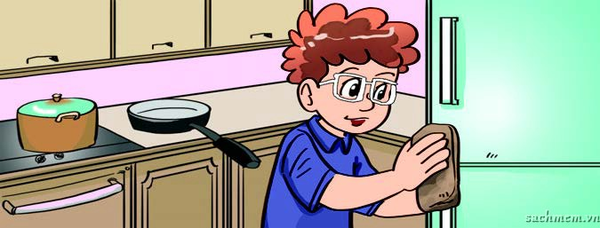

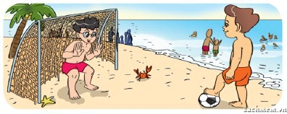
4. Look and write.
1. A: Where was Tom yesterday?
B: He was ________________.
at home
2. A: Where was Linda yesterday?
B: She was________________.
in the school library
3. A: Where were Phong and Nam yesterday?
B: They were ______________.
on the beach

Slide 14
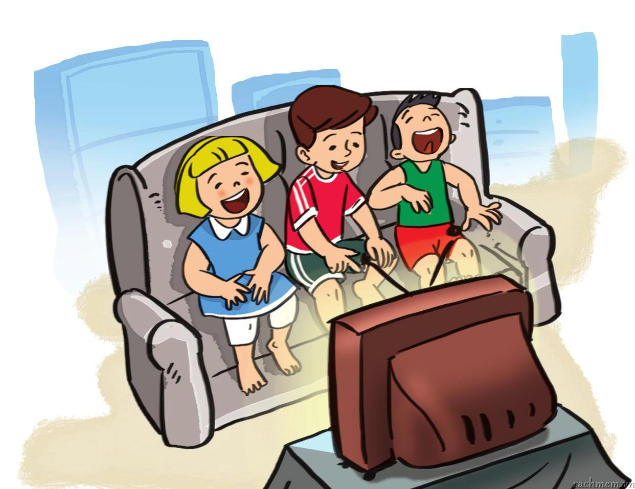
5. Let’s sing.
Where were you yesterday?
Where were you yesterday?
Yesterday, yesterday?
Where were you yesterday?
I was at home.
What did you do yesterday?
Yesterday, yesterday?
What did you do yesterday?
We watched TV.

Slide 15


- Learn by heart the sing.

Slide 16

Thank you for your attention !
Goodbye
See you again

